Slide 1
Myanmar Handwriting Recognition Experiment Models

Slide 2
Contents
Aung Hein
01 May 2026
01.
Features Embedding
02.
Prototypes + Segmental HMM
03.
CTC + BiLSTM
04.
CTC + WFST

Slide 3
Overview
As part of an AI Foundation course assignment, I experimented with machine learning models for Myanmar handwriting recognition. The dataset includes over 4,000 syllables, with at least three handwritten samples collected for each syllable. In total, three different models were tested, achieving a maximum accuracy of approximately 94% in a low-cost, CPU-only environment.

Slide 4
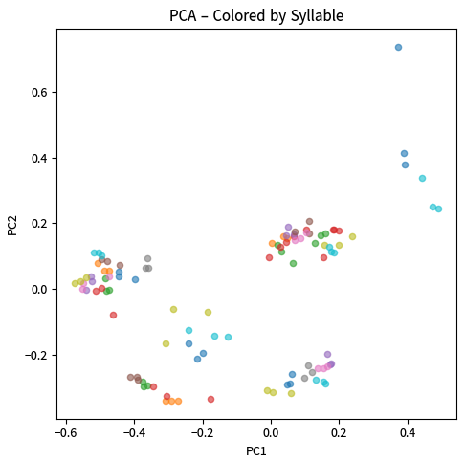
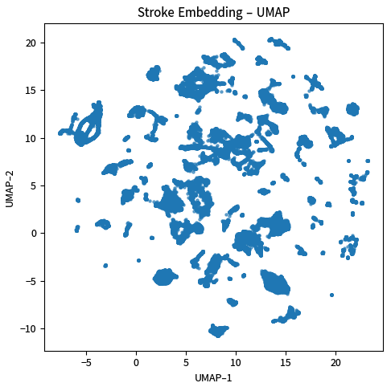
Features Embedding
Aung Hein
01 May 2026
In this assignment, each handwriting sample is represented using extracted stroke-level features before being used by the recognition models. The feature vector is organized into 12 feature groups, where each group captures a different aspect of handwriting structure, movement, and spatial layout.
geom – stroke shape & size
pause – pen-up timing gaps
turn – direction changes
progression – writing flow
zone_pct_cov – zone coverage %
zone_active – active zones
line_rel – position vs baseline
dot – small/dot strokes
direction_hist – stroke directions
curvature_hist – stroke bending
projection_hist – spatial density
local_grid – fine local structure

Slide 5
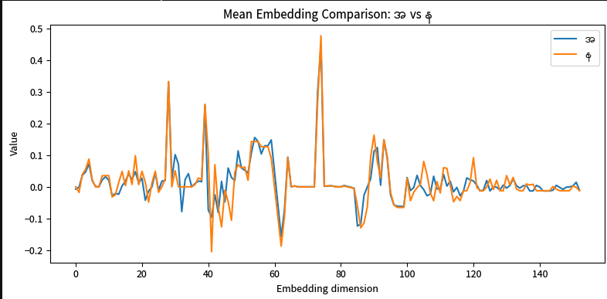
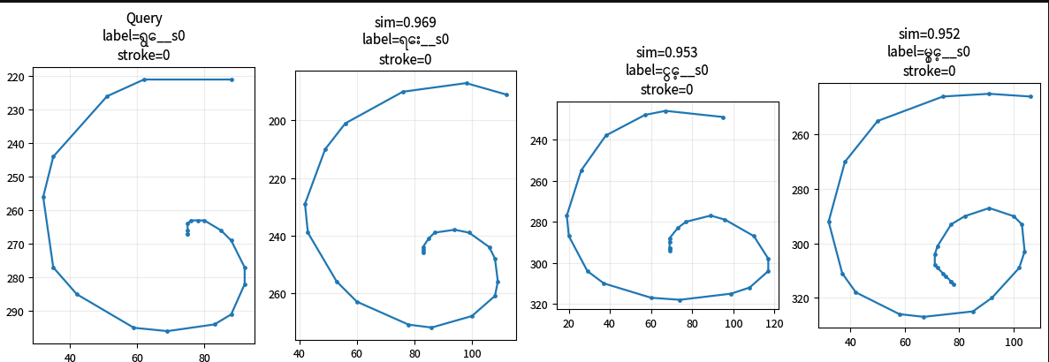
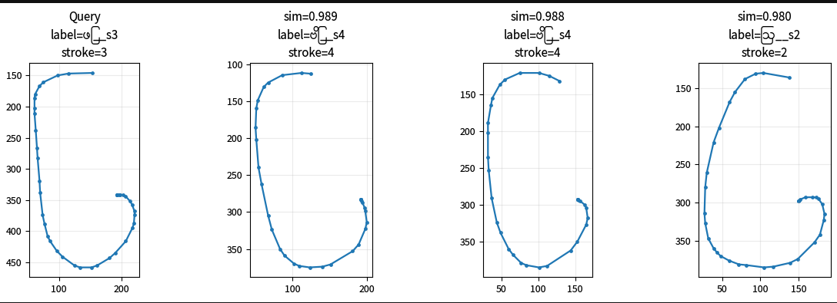
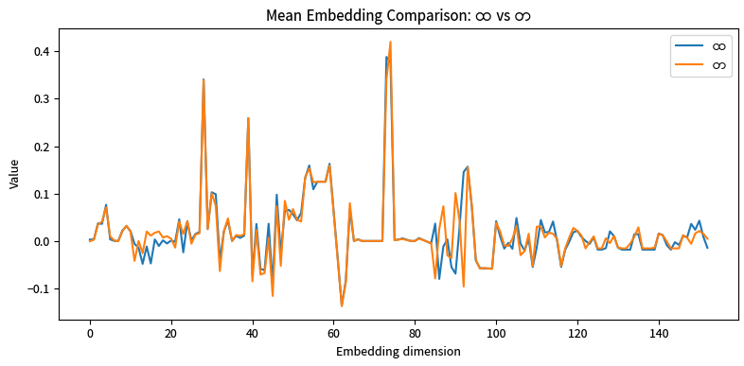
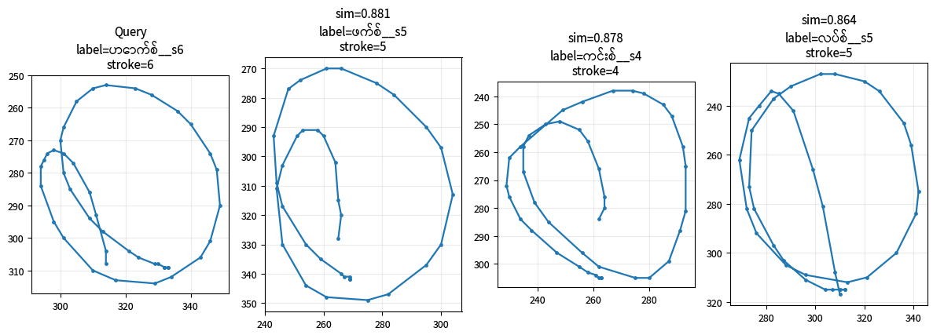
Features Embedding
Aung Hein
01 May 2026
Mean Embedding Comparison
Sample neighbours

Slide 6
Model - 1:
Syllable Prototype + Unit Prototype Segmental HMM (Hybrid Scoring)
Aung Hein
01 May 2026
Model‑1 combines global syllable prototype matching with local unit-level segmental HMM scoring, then predicts the final syllable using a hybrid score.

Slide 7
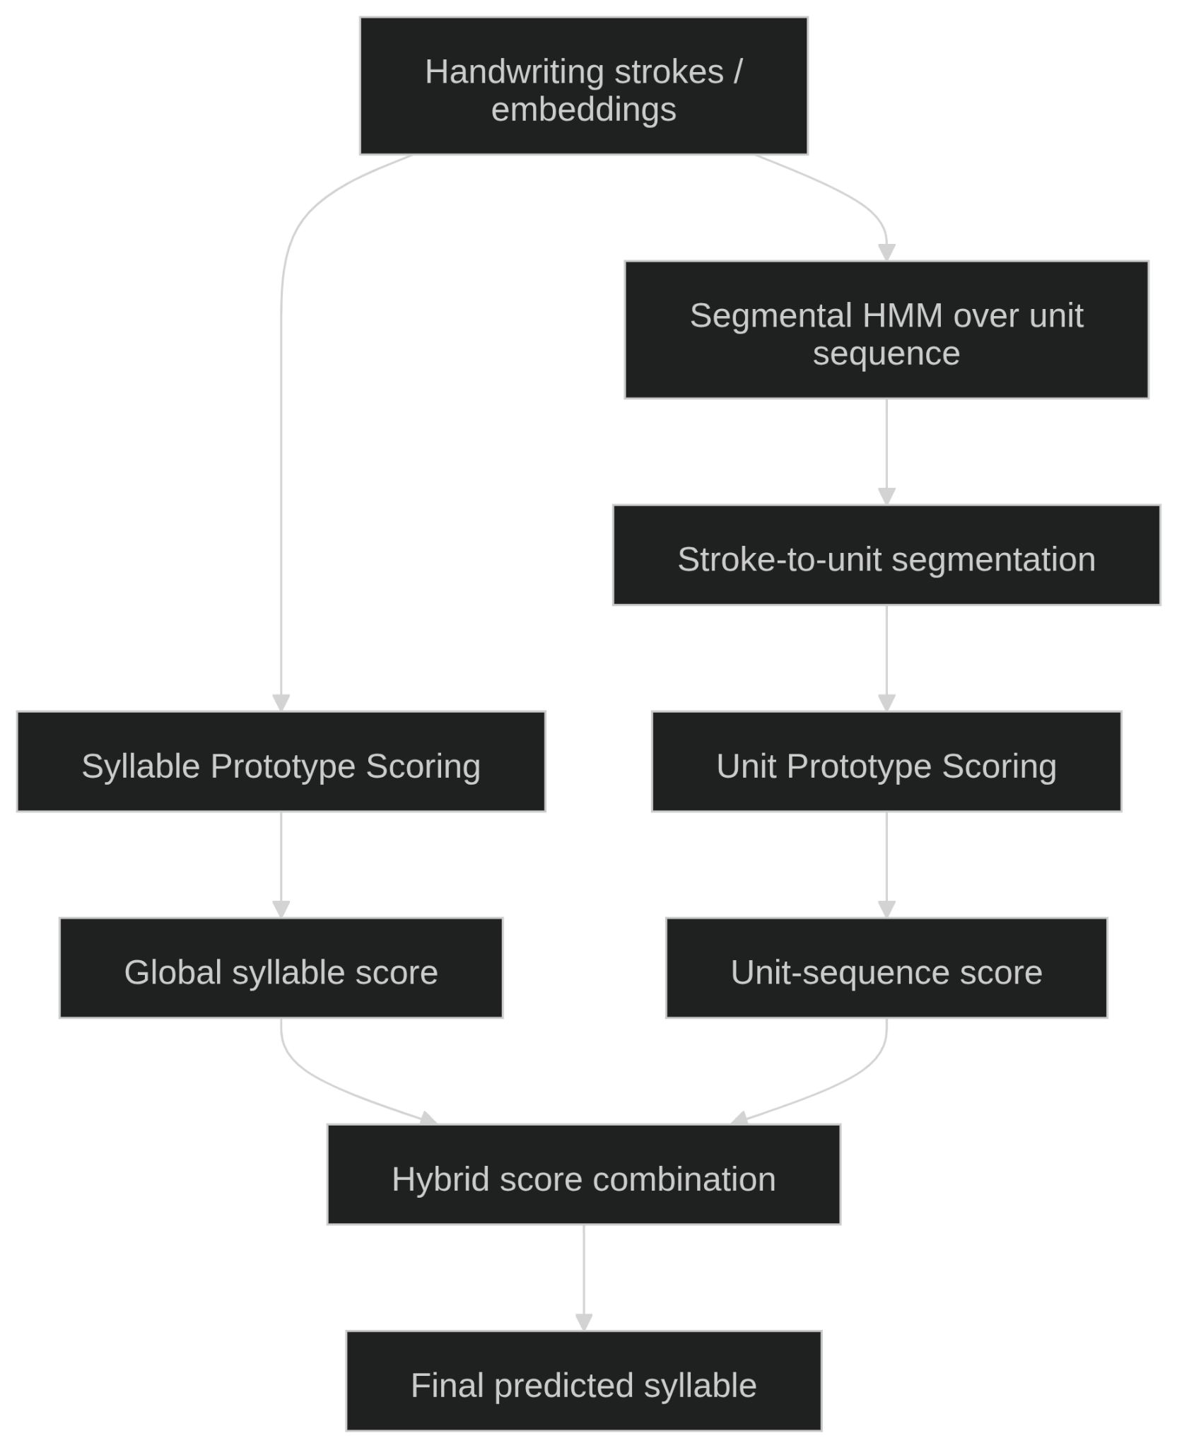
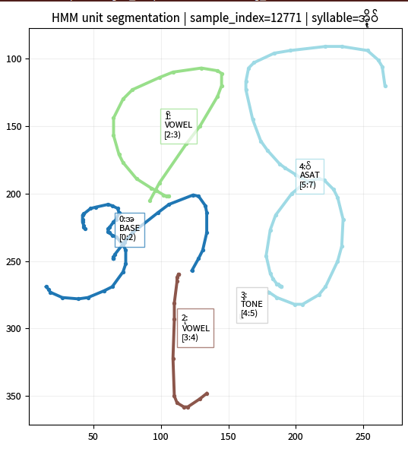
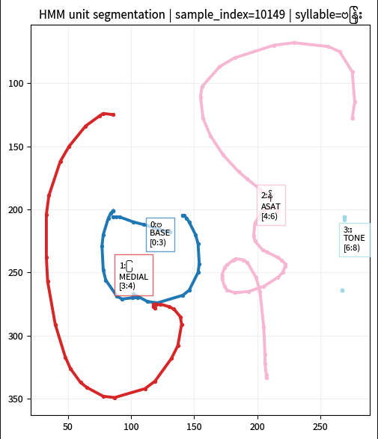
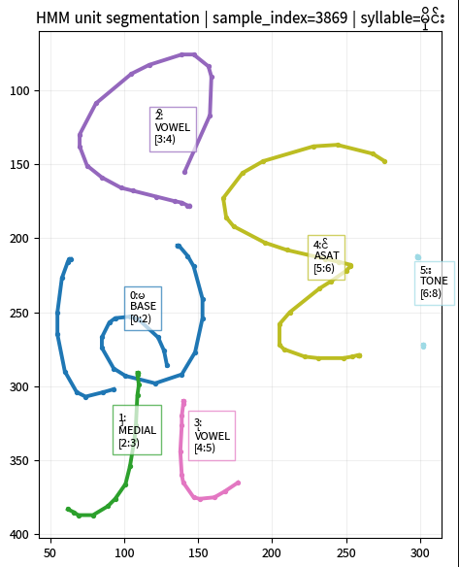
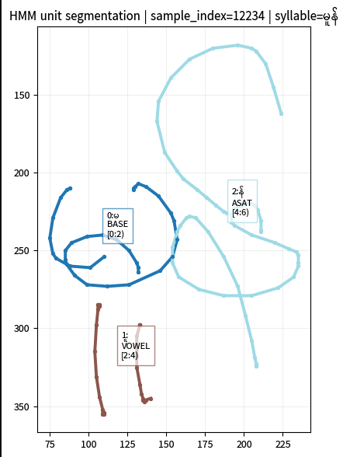
Syllable Prototype + Unit Prototype Segmental HMM
Aung Hein
01 May 2026
Syllable Prototype Accuracy
Top-N Candidates :
Top-1 : 0.787
Top-5 : 0.922
Top-10 : 0.947
Final Hybrid Accuracy
Top-N Candidates :
Top-1 : 0.798
Top-5 : 0.936
Top-10 : 0.955
Sample Units Segmentation by HMM

Slide 8
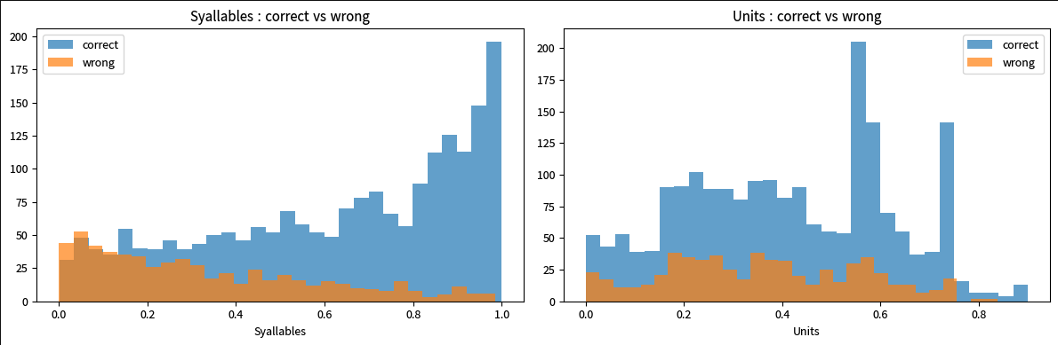
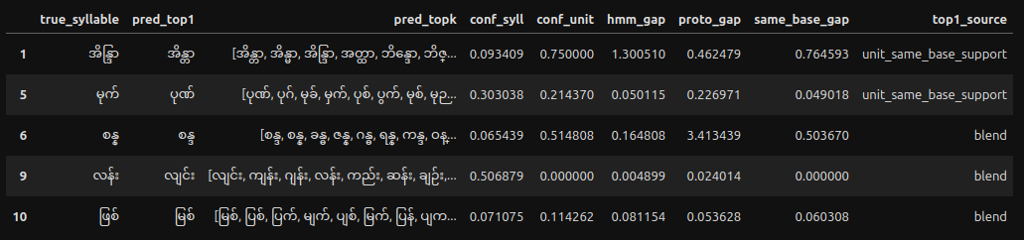
Syllable Prototype + Unit Prototype Segmental HMM
Aung Hein
01 May 2026
Candidate Score Histogram
Confusion Sample

Slide 9
Model - 2:
CTC Pre-trained Encoder + BiLSTM Syllable Classifier
Aung Hein
01 May 2026
Model‑2 first trains a BiLSTM encoder with CTC to learn unit-aware features from stroke embeddings. Then it reuses that encoder (usually frozen) and adds another BiLSTM classification head to predict syllables directly from encoder features.

Slide 10
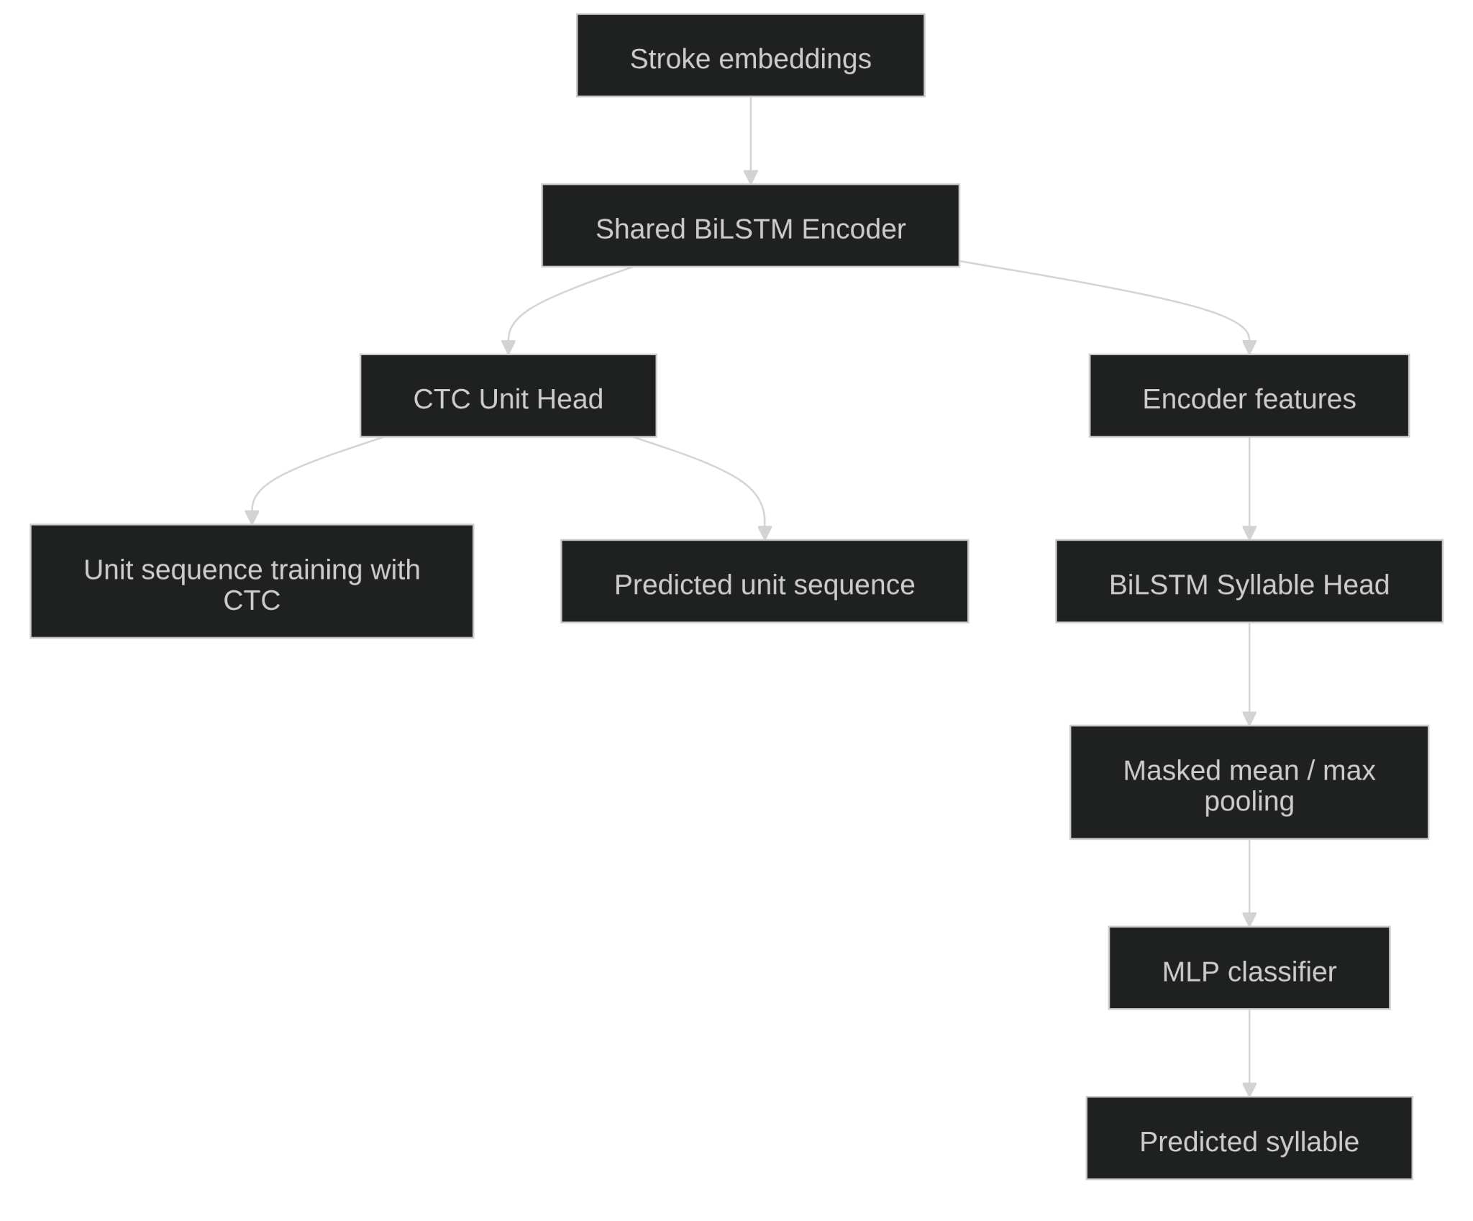
CTC Pre-trained Encoder + BiLSTM Syllable Classifier
Aung Hein
01 May 2026
Unit Accuracy ( by CTC )
Validation : 0.941
Test : 0.938
CTC + BiLSTM Accuracy
Validation :
Top 1 : 0.892
Top 5 : 0.962
Top 10 : 0.977
Test :
Top 1 : 0.906
Top 5 : 0.970
Top 10 : 0.987
Prediction Statistics ( test dataset )
Case | Count | Ratio
unit_correct_syllable_correct | 844 | 0.871001032
unit_correct_syllable_wrong | 68 | 0.0701754386
unit_wrong_syllable_wrong | 36 | 0.03715170279
unit_wrong_syllable_correct | 21 | 0.02167182663

Slide 11
CTC Pre-trained Encoder + BiLSTM Syllable Classifier
Aung Hein
01 May 2026
Confusion Sample ( unit_correct_syllable_wrong )
sample_index | true_syllable | pred_top1 | gt_units | pred_units | case
45 | တွေ | တွေ့ | ['တ', 'ွ', 'ေ'] | ['တ', 'ွ', 'ေ'] | unit_correct_syllable_wrong
194 | ဗျား | ဖျား | ['ဗ', 'ျ', 'ာ', 'း'] | ['ဗ', 'ျ', 'ာ', 'း'] | unit_correct_syllable_wrong
228 | နာ | နှာ | ['န', 'ာ'] | ['န', 'ာ'] | unit_correct_syllable_wrong
707 | ရုံ | ရုင် | ['ရ', 'ု', 'ံ'] | ['ရ', 'ု', 'ံ'] | unit_correct_syllable_wrong
867 | နော် | နော့် | ['ေန', 'ာ', '်'] | ['ေန', 'ာ', '်'] | unit_correct_syllable_wrong
Confusion Sample ( unit_correct_syllable_wrong )
sample_index | true_syllable | pred_top1 | gt_units | pred_units | case
122 | နိုင် | နိုင် | ['န', 'ိ', 'ု', 'င်'] | ['န', 'ိ', 'င်'] | unit_wrong_syllable_correct
276 | စု | စု | ['စ', 'ု'] | ['ရ'] | unit_wrong_syllable_correct
442 | နှင့် | နှင့် | ['န', 'ှ', 'င်', '့'] | ['ဒ', 'င်', '့'] | unit_wrong_syllable_correct
1803 | ခွေး | ခွေး | ['ခ', 'ွ', 'ေ', 'း'] | ['ဒ', 'ွ', 'ေ', 'း'] | unit_wrong_syllable_correct
3494 | တင့် | တင့် | ['တ', 'င်', '့'] | ['တ', 'င', '့', '်'] | unit_wrong_syllable_correct
Confusion Sample ( unit_wrong_syllable_wrong )
sample_index | true_syllable | pred_top1 | gt_units | pred_units | case
64 | ဖြစ် | ဖြဲ | ['ဖ', 'ြ', 'စ်'] | ['ပ', 'ြ', 'စ်'] | unit_wrong_syllable_wrong
131 | လေး | ကေး | ['ေလ', 'း'] | ['ေယ', 'း'] | unit_wrong_syllable_wrong
193 | ဗျား | ပျား | ['ဗ', 'ျ', 'ာ', 'း'] | ['ပ', 'ျ', 'ာ', 'း'] | unit_wrong_syllable_wrong
266 | လောက် | ယောက် | ['ေလ', 'ာ', 'က်'] | ['ေယ', 'ာ', 'က်'] | unit_wrong_syllable_wrong
361 | ဝင် | ဝဂ် | ['ဝ', 'င်'] | ['ဝ', 'ဂ်'] | unit_wrong_syllable_wrong

Slide 12
Model - 3:
CTC Unit Model + WFST Lexicon Decoder
Aung Hein
01 May 2026
Model‑3 first predicts unit sequences from stroke embeddings using a CTC-based BiLSTM encoder, then decodes the N-best unit paths with a WFST lexicon to produce the final syllable prediction.

Slide 13
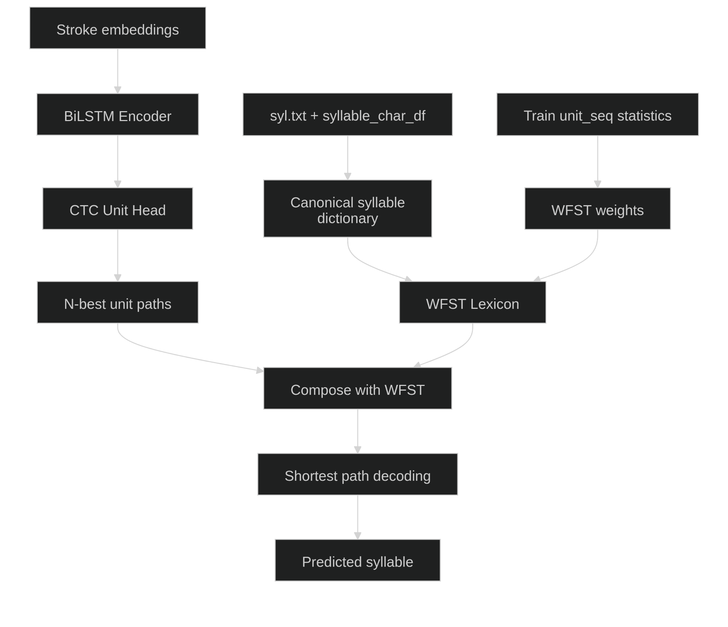
CTC Unit Model + WFST Lexicon Decoder
Aung Hein
01 May 2026
Unit Accuracy ( by CTC )
Validation : 0.941
Test : 0.929
CTC + WFST Accuracy
Validation :
Top 1 : 0.948
Top 5 : 0.976
Top 10 : 0.976
Test :
Top 1 : 0.942
Top 5 : 0.972
Top 10 : 0.972
Prediction Statistics ( test dataset )
case | count | ratio
unit_correct_syllable_correct | 2373 | 0.930588
unit_correct_syllable_wrong | 15 | 0.005882
unit_wrong_syllable_wrong | 132 | 0.051765
unit_wrong_syllable_correct | 30 | 0.011765

Slide 14
CTC Unit Model + WFST Lexicon Decoder
Aung Hein
01 May 2026
Confusion Sample ( unit_correct_syllable_wrong )
sample_index | true_syllable | true_units | pred_units_ctc | pred_top1 | pred_topk | decode_distance
3305 | ယောင်း | [ေယ, ာ, င်, း] | [ေယ, ာ, င်, း] | ကာင်း | [ကာင်း, ကောင်း] | 8.386525
3307 | ယောင်း | [ေယ, ာ, င်, း] | [ေယ, ာ, င်, း] | None | [] | NaN
4077 | ငေါက် | [ေင, ါ, က်] | [ေင, ါ, က်] | ဒေါက် | [ဒေါက်] | 9.008787
4794 | ဖော | [ေဖ, ာ] | [ေဖ, ာ] | ဃော | [ဃော, ဗော, ဟော] | 8.856107
5406 | ပြွမ်း | [ပ, ြ, ွ, မ်, း] | [ပ, ြ, ွ, မ်, း] | None | [] | NaN
Confusion Sample ( unit_wrong_syllable_correct )
sample_index | true_syllable | true_units | pred_units_ctc | pred_top1 | pred_topk | decode_distance
866 | နော် | [ေန, ာ, ်] | [ေန, ်] | နော် | [နော်, နေက်, နေ့, နောက်] | 3.655353
970 | ရှင်း | [ရ, ှ, င်, း] | [ဂ, ှ, င်, း] | ရှင်း | [ရှင်း, ဂျင်း] | 3.665559
1018 | ဦး | [ဥ, ီ, း] | [ဥ, း] | ဦး | [ဦး, ခီး] | 3.576554
1418 | ဤ | [ဤ] | [က, ဤ] | ဤ | [ဤ, ကဋ်, ကပ်, ဋ်, ပ်] | 2.954883
3076 | မည့် | [မ, ည်, ့] | [မ, ည်, ်] | မည့် | [မည့်, မည့်] | 2.247309
Confusion Sample ( unit_wrong_syllable_wrong )
sample_index | true_syllable | true_units | pred_units_ctc | pred_top1 | pred_topk | decode_distance
47 | တွေ | [တ, ွ, ေ] | [တ, ွ, ေ, ့] | တွေ့ | [တွေ့, တွေ, တေ့, တေ] | 1.189078
63 | ဖြစ် | [ဖ, ြ, စ်] | [ပ, ြ, စ်] | ပြစ် | [ပြစ်, ပစ်, ပျစ်, ဖြစ်, ပုစ်] | 0.900143
114 | လို့ | [လ, ိ, ု, ့] | [က, ိ, ု, ့] | ကို့ | [ကို့, လို့, ဂို့, ကို, စို့, လို, ဂို] | 0.971038
177 | ခု | [ခ, ု] | [ဍ] | ဍ | [ဍ, ဥ, ဋ, န, ခ] | 0.951035
321 | နှ | [န, ှ] | [ဒ] | ဒ | [ဒ, န, ဌ, ဠ, အ] | 0.832802

Slide 15
Any questions? Ask away!

Slide 16
Thank you
Aung Hein
01 May 2026

